Slide 1


Building Resilience through Data
Creating a Database for Economic Impact Analysis using MySQL Workbench
By: Jemael Nzihou – Process Engineer, Data Scientist, Veteran Leader
by Jemael Nzihou

Slide 2
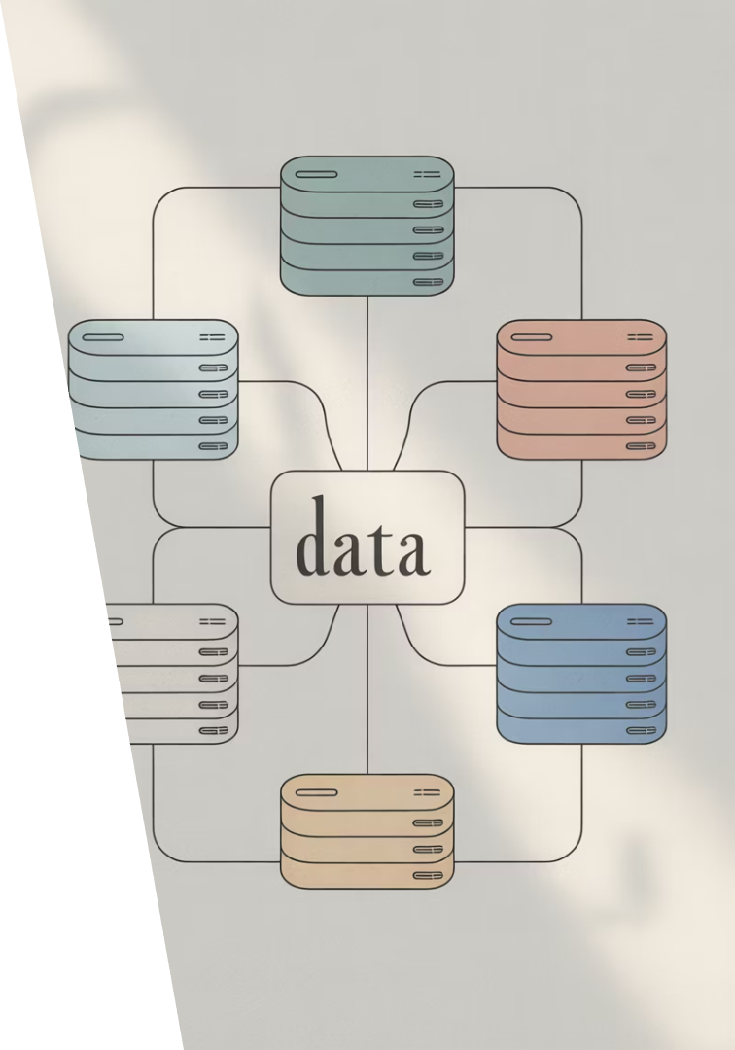
What is a Database?
Definition
Types
Structured collection of data stored electronically
Relational (MySQL) and NoSQL (MongoDB)
Purpose
Store variables, maintain integrity, enable analysis

Slide 3





Who Uses Databases the Most?
Manufacturing
Healthcare
Finance
KPIs, defects, cycle times
Patient records, diagnostics
Transactions, risk analysis
Retail
Inventory, customer behavior

Slide 4
When and Why Are Databases Crucial?
When?
Why?
Process improvement initiatives
Supports data-driven decisions
During crises (COVID-19)
Prevents data loss
Continuous quality monitoring
Enables trend detection

Slide 5








Where Do We See Major Importance?
Manufacturing
BI Platforms
Cycle time reduction, cost analytics
Dashboards, ROI metrics
Six Sigma
Data Science
DMAIC analytics, Lean initiatives
Model training & evaluation

Slide 6




COVID-19 and Data-Driven Systems
Challenge
Disrupted supply chains & workforce
Response
Need for BI tools & historical data
Solution
MySQL database for project tracking

Slide 7

Overview of the Database Created
Schema
mydatabase
Table 1
Projects: project_id, name, manager, dates
Table 2
KPI_Tracking: kpi_id, project_id (FK), values
Table 3
Cost_Savings: saving_id, project_id (FK), ROI
Features
Foreign keys, normalization, mixed data types

Slide 8

Implementation Walkthrough
Create Schema
File > New Query Tab > CREATE SCHEMA mydatabase
Build Tables
Create tables with fields and types
Define Relationships
Set foreign keys between tables
Generate Diagram
Database > Reverse Engineer > EER Diagram

Slide 9
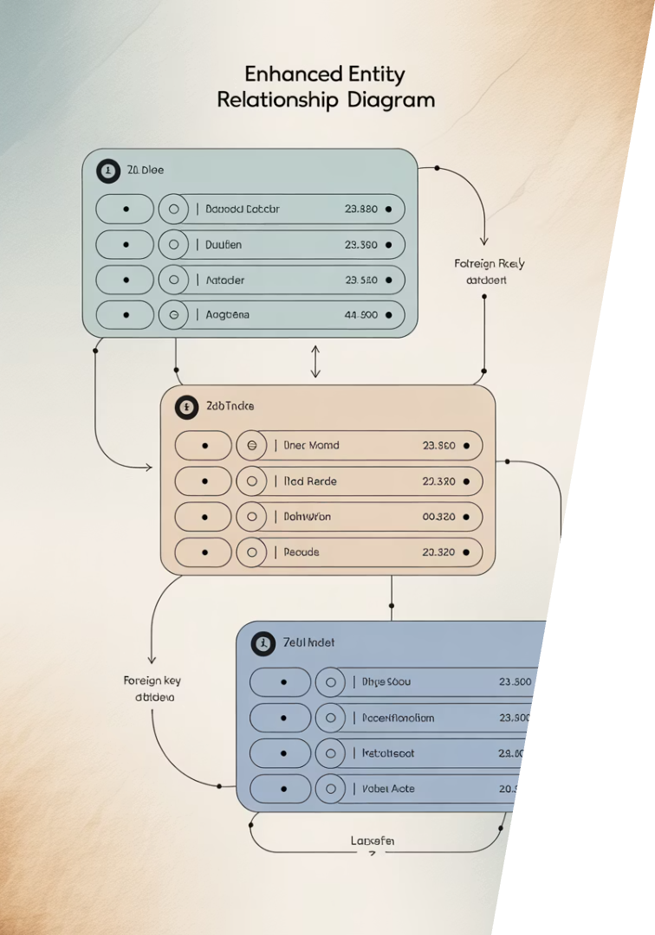
EER Diagram & Relational Model
Shows relationships between tables using foreign keys
Highlights normalized structure to reduce redundancy

Slide 10
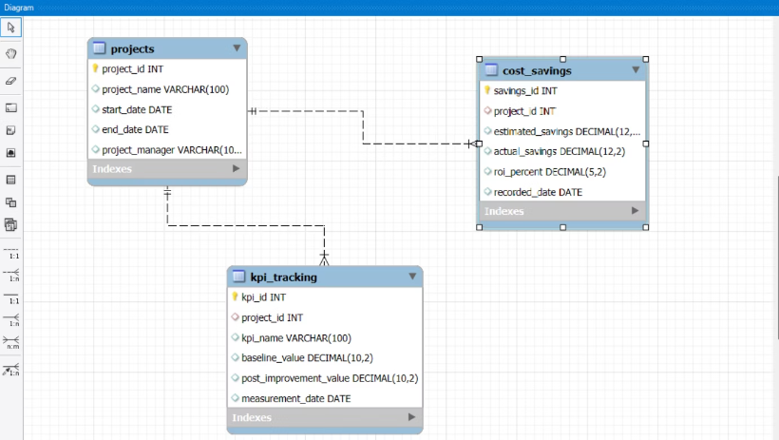
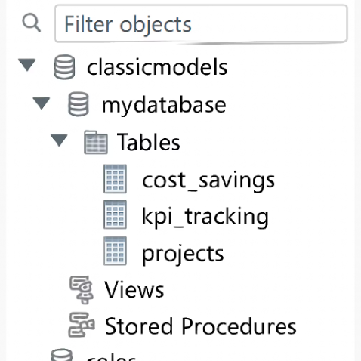

Slide 11
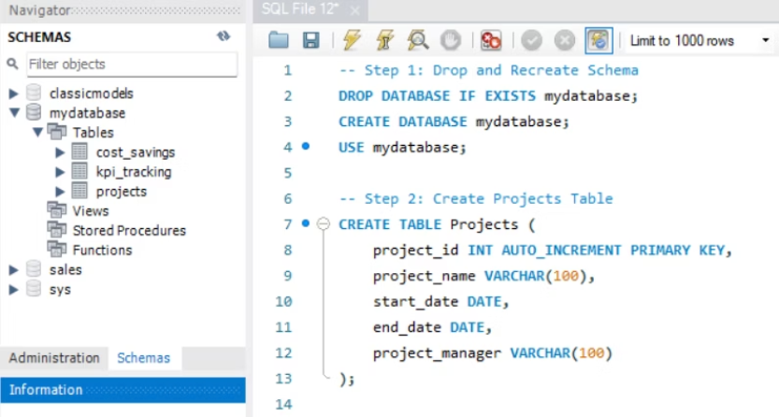
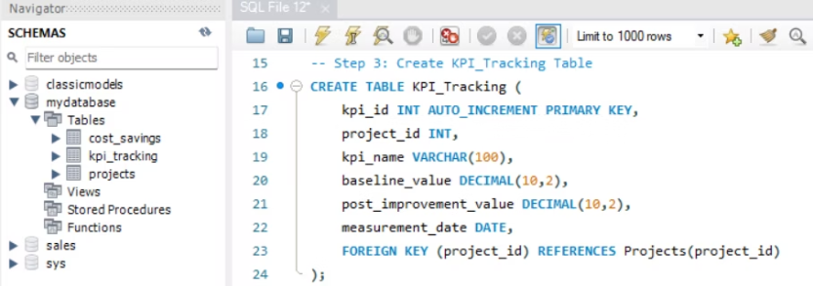
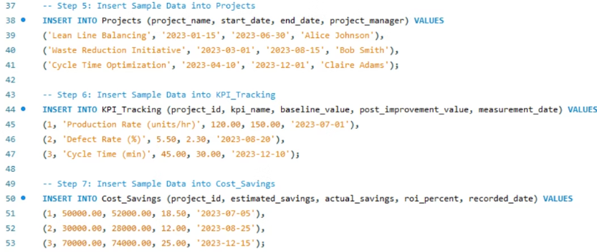
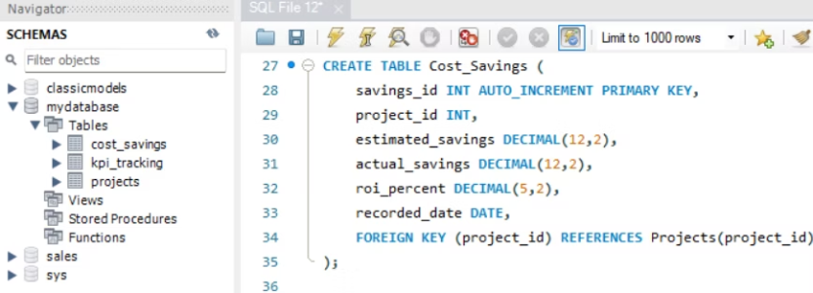

Slide 12






Strategic Importance of the Database
Decision Agility
Rapid response to market changes
ROI Visibility
Clear tracking of financial impact
Longitudinal Analysis
Track changes over time

Slide 13




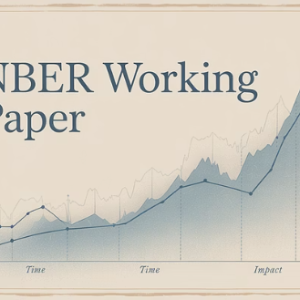
Scholarly and Industry Relevance
Key references supporting database design principles and business intelligence applications

Slide 14




Final Thoughts
Foundation
Visibility
Strategy
MySQL database enabled meaningful BI
Enhanced pre/post-COVID comparisons
Informed data-driven decision-making

Slide 15



Contact and Acknowledgment
Jemael Nzihou
Portfolio
Contact
Process Engineer, Data Scientist
Zabatissu | jemael.modelingfolio.com
jemaelnzihou@gmail.com | 402-430-5219

